Slide 1
PROPERTY TABLES

Slide 2
PROPERTY TABLES
For most substances, the relationships among thermodynamic properties are too complex to be expressed by simple equations.
Therefore, properties are frequently presented in the form of tables.
Some thermodynamic properties can be measured easily, but others cannot and are calculated by using the relations between them and measurable properties.
The results of these measurements and calculations are presented in tables in a convenient format.
For each substance, the thermodynamic properties are listed in more than one table.
In fact, a separate table is prepared for each region of interest such as the superheated vapor, compressed liquid, and saturated (mixture) regions.

Slide 3
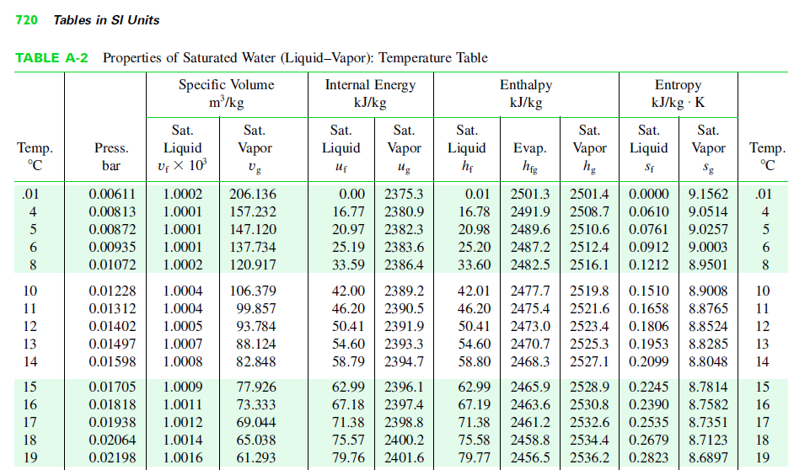
Table A–4

Slide 4
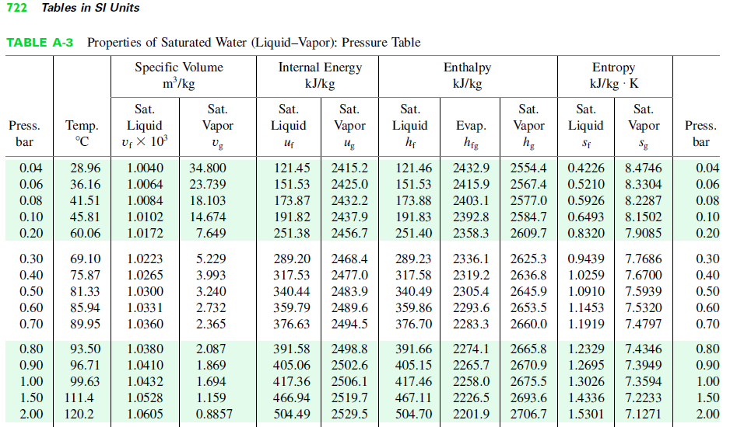
Tables A–5

Slide 5
Saturated Liquid and Saturated Vapor States
The properties of saturated water (liquid and vapor) are listed in Tables A–4 and A–5.
Both tables give the same information.
The only difference is that in Table A–4 properties are listed under temperature and in Table A–5 under pressure.
Therefore, it is more convenient to use Table A–4 when temperature is given and Table A–5 when pressure is given.

Slide 6
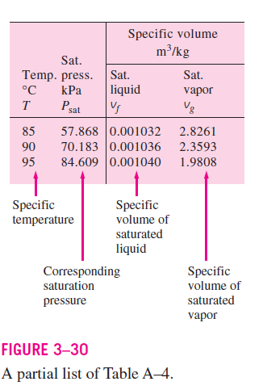
The subscript ‘f’ is used to denote properties of a saturated liquid, and the subscript ‘g’ to denote the properties of saturated vapor.
Another subscript commonly used is ‘fg’ which denotes the difference between the saturated vapor and saturated liquid values of the same property.
For example,
v_{f} = specific volume of saturated liquid
v_{g} = specific volume of saturated vapor
v_{fg} = difference between v_{g} and v_{f}
(v_{fg} = v_{g} - v_{f} )

Slide 7
The quantity h_{fg} is called the enthalpy of vaporization (or latent heat of vaporization).
It represents the amount of energy needed to vaporize a unit mass of saturated liquid at a given temperature or pressure.
It decreases as the temperature or pressure increases and becomes zero at the critical point.

Slide 8
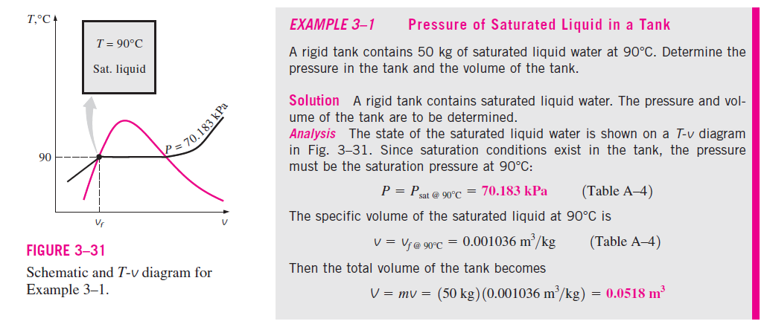

Slide 9
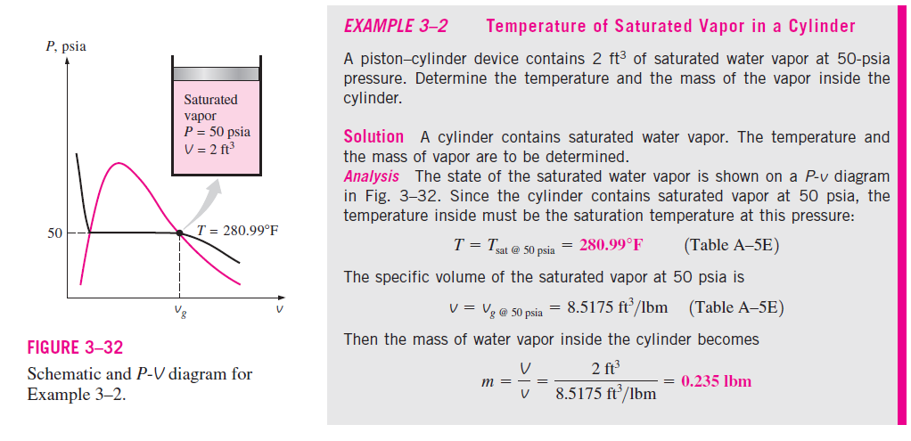

Slide 10
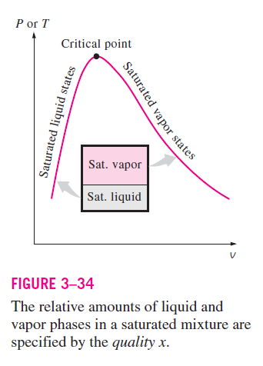

Saturated Liquid–Vapor Mixture
To analyze the mixture properly, we need to know the proportions of the liquid and vapor phases in the mixture.
This is done by defining a new property called the quality (x) as the ratio of the mass of vapor to the total mass of the mixture:
Where
m_{total} = m_{liquid} + m_{vapor}
= m_{f} + m_{g}

Slide 11
Quality has significance for saturated mixtures only.
It has no meaning in the compressed liquid or superheated vapor regions.
Its value is between 0 and 1.
The quality of a system that consists of saturated liquid is 0 (or 0 percent), and the quality of a system consisting of saturated vapor is 1 (or 100 percent).
A state of 50 percent quality lies in the middle of this horizontal line.
The properties of the saturated liquid are the same whether it exists alone or in a mixture with saturated vapor.
During the vaporization process, only the amount of saturated liquid changes, not its properties.
The same can be said about a saturated vapor.

Slide 12
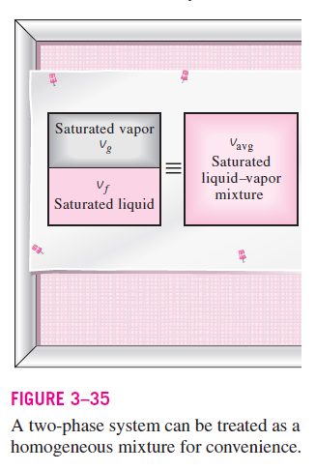
A saturated mixture can be treated as a combination of two subsystems: the saturated liquid and the saturated vapor.
However, the amount of mass for each phase is usually not known.
Therefore, it is often more convenient to imagine that the two phases are mixed well, forming homogeneous mixture (Fig. 3–35).

Slide 13
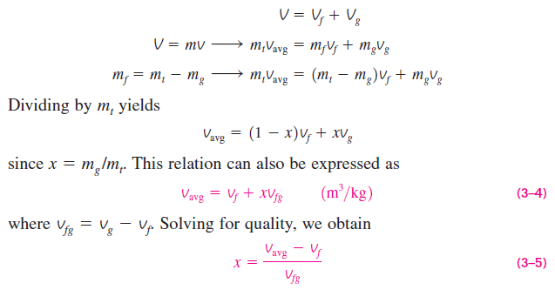
Then the properties of this “mixture” will simply be the average properties of the saturated liquid–vapor mixture under consideration.
Consider a tank that contains a saturated liquid–vapor mixture. The volume occupied by saturated liquid is V_{f}, and the volume occupied by saturated vapor is V_{g}.
The total volume V is the sum of the two:

Slide 14
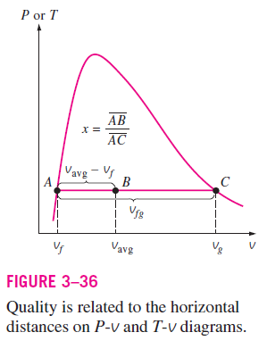
Based on this equation, quality can be related to the horizontal distances on a P-v or T-v diagram (Fig. 3–36).
At a given temperature or pressure, the numerator of Eq. 3–5 is the distance between the actual state and the saturated liquid state, and the denominator is the length of the entire horizontal line that connects the saturated liquid and saturated vapor states.

Slide 15

The analysis given above can be repeated for internal energy and enthalpy with the following results:

Slide 16
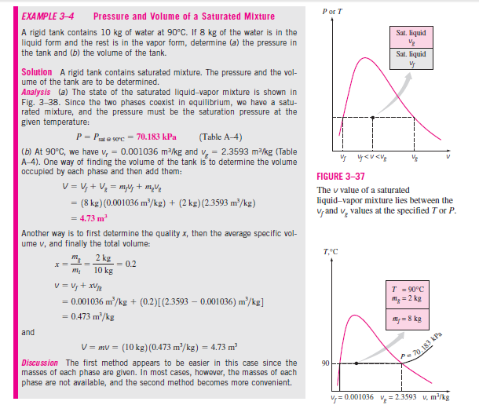


Slide 17
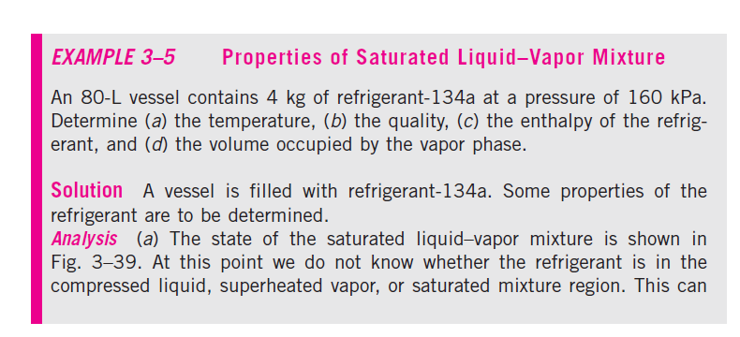
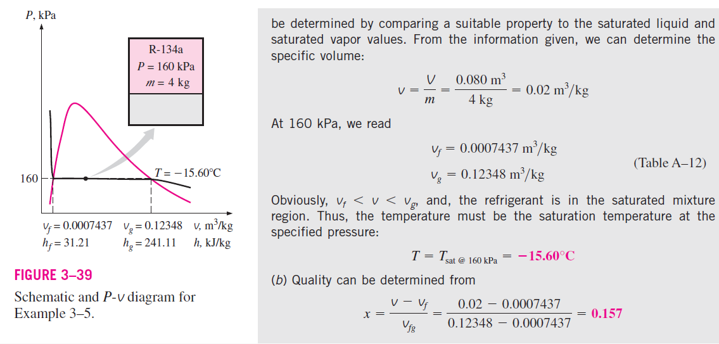

Slide 18
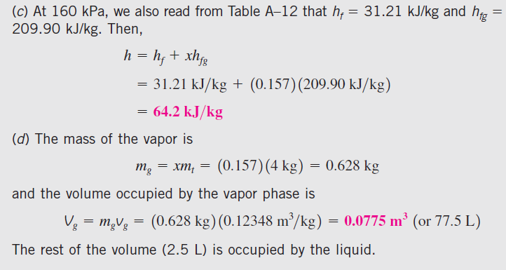

Slide 19
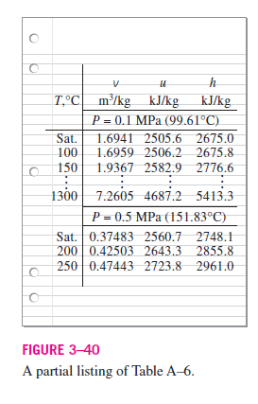
Superheated Vapor
In the region to the right of the saturated vapor line and at temperatures above the critical point temperature, a substance exists as superheated vapor
Since the superheated region is a single-phase region (vapor phase only), temperature and pressure are no longer dependent properties and they can conveniently be used as the two independent properties in the tables.
In these tables, the properties are listed against temperature for selected pressures starting with the saturated vapor data
The saturation temperature is given in parentheses following the pressure value

Slide 20
Compared to saturated vapor, superheated vapor is characterized by
Lower pressures (P < P_{sat} at a given T)
Higher temperatures (T > T_{sat} at a given P)
Higher specific volumes (v > v_{g} at a given P or T)
Higher internal energies (u > u_{g} at a given P or T)
Higher enthalpies (h > h_{g} at a given P or T)

Slide 21
Compressed Liquid
Compressed liquid tables are not as commonly available
The format of Table A–7 is very much like the format of the superheated vapor tables.
One reason for the lack of compressed liquid data is the relative independence of compressed liquid properties from pressure.
Variation of properties of compressed liquid with pressure is very mild.
Increasing the pressure 100 times often causes properties to change less than 1 percent.
In the absence of compressed liquid data, a general approximation is to treat compressed liquid as saturated liquid at the given temperature
This is because the compressed liquid properties depend on temperature
much more strongly than they do on pressure.

Slide 22
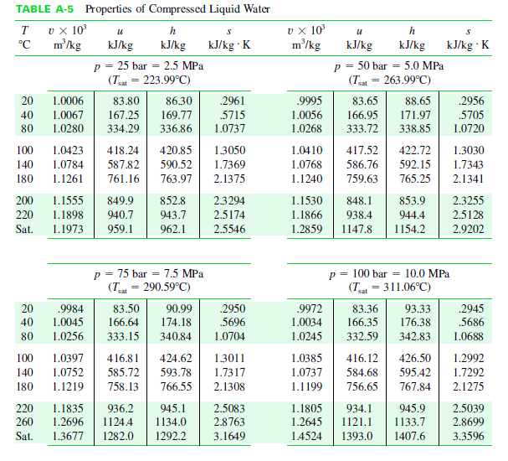

Slide 23
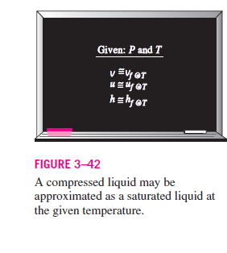

Of these three properties, the property whose value is most sensitive to variations in the pressure is the enthalpy h.
Although the above approximation results in negligible error in v and u, the error in h may reach undesirable levels
However, the error in h at low to moderate pressures and temperatures can be reduced significantly by evaluating it from

Slide 24
In general, a compressed liquid is characterized by
Higher pressures (P > P_{sat} at a given T)
Lower temperatures (T < T_{sat} at a given P)
Lower specific volumes (v < v_{f} at a given P or T)
Lower internal energies (u < u_{f} at a given P or T)
Lower enthalpies (h < h_{f} at a given P or T)

Slide 25
Reference State and Reference Values
The values of u, h, and s cannot be measured directly, and they are calculated
from measurable properties using the relations between thermodynamic properties.
However, those relations give the changes in properties, not the values of properties at specified states.
Therefore, we need to choose a convenient reference state and assign a value of zero for a convenient property or properties at that state.
For water, the state of saturated liquid at 0.01°C is taken as the reference state, and the internal energy and entropy are assigned zero values at that state.
For refrigerant-134a, the state of saturated liquid at - 40°C is taken as the reference state, and the enthalpy and entropy are assigned zero values at that state.

Slide 26
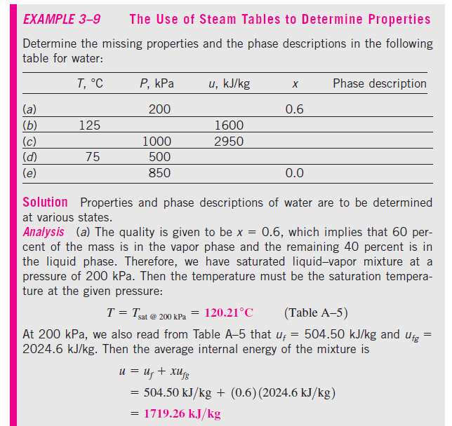

Slide 27
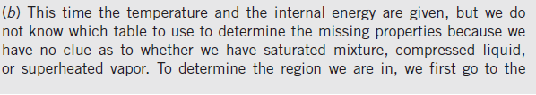
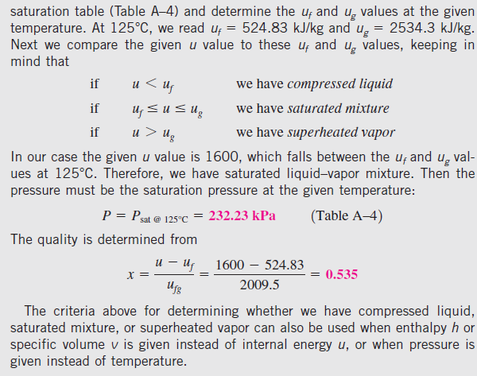

Slide 28
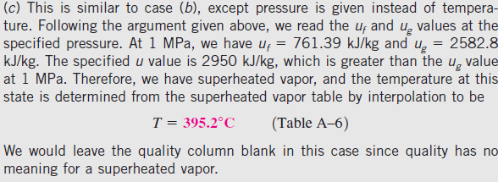
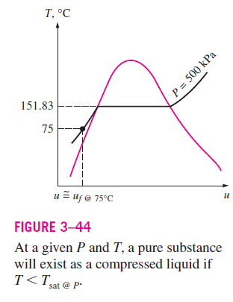
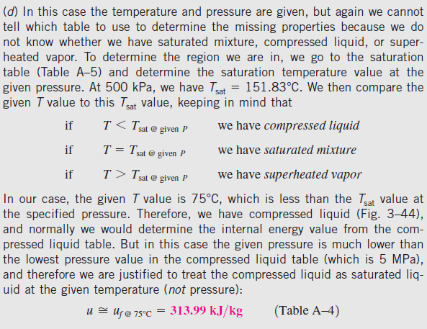

Slide 29
